Slide 1
eCommerce Customer Service Satisfaction
Presented by: Isabelle

Slide 2
Problem Statement
Shopzilla is facing high cost for customer acquisition, which affects it’s profit. Study shows that customer lifetime value is directly proportional to the retention rate. A 5% increase in customer retention can produces more than 25% increase in profit. The company is currently working to improve customer service quality, enhance overall customer satisfaction, and increase customer retention.

Slide 3
Objectives
1. Classify CSAT score
2. Evaluate Model Performance
3. Provide recommendations based on the model's performance

Slide 4
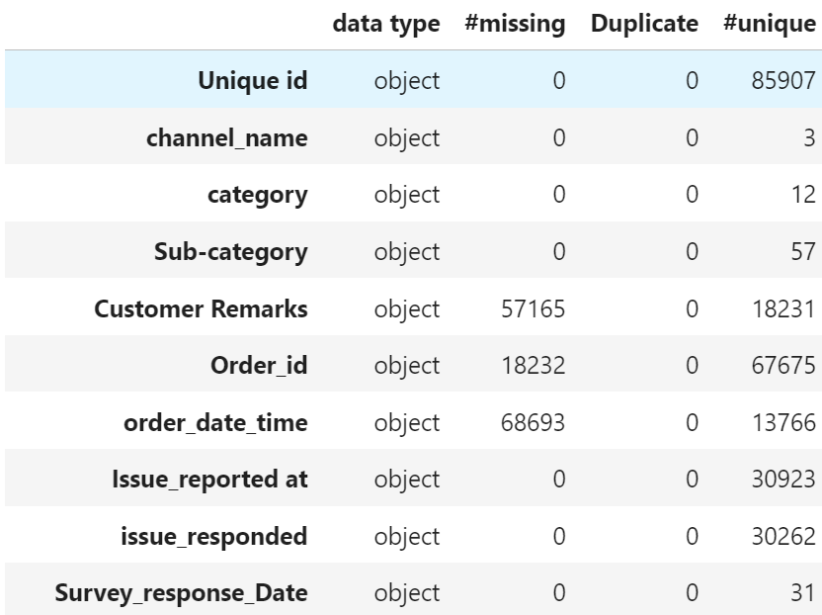

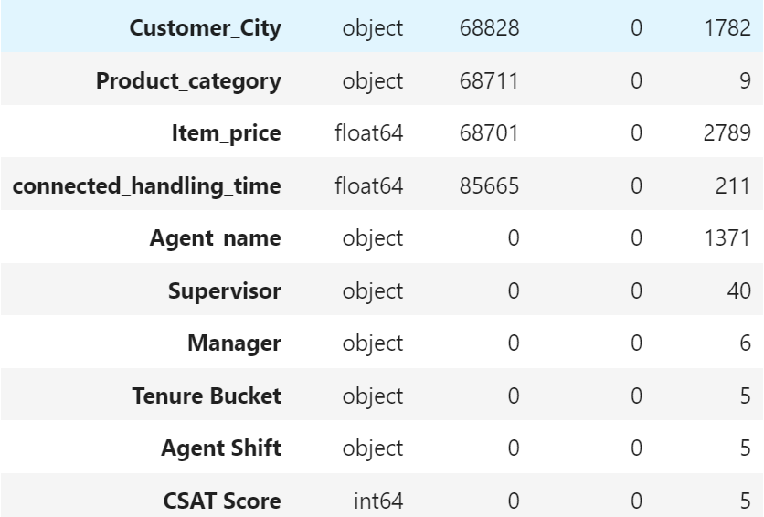

Challenges: Missing values and high cardinality
https://www.kaggle.com/datasets/ddosad/ecommerce-customer-service-satisfaction?resource=download

Slide 5
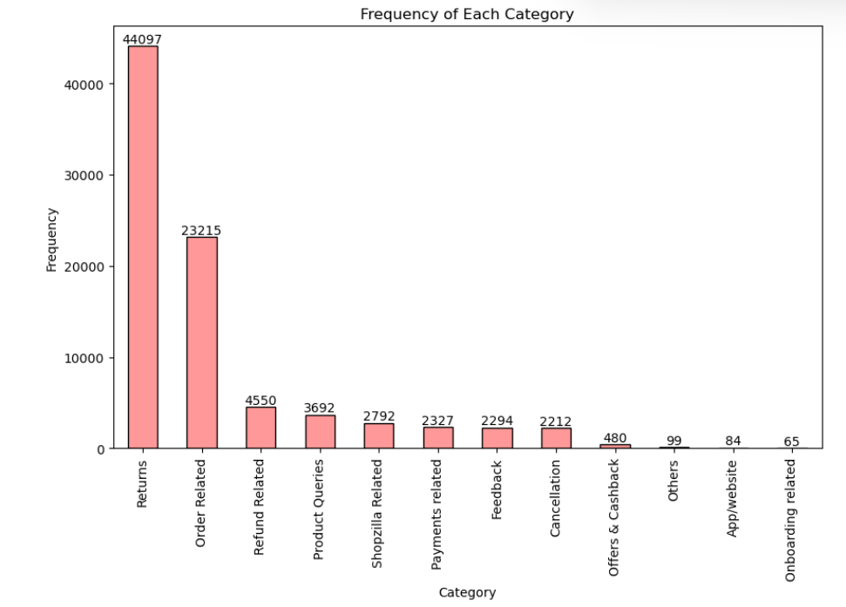
Category column

Slide 6
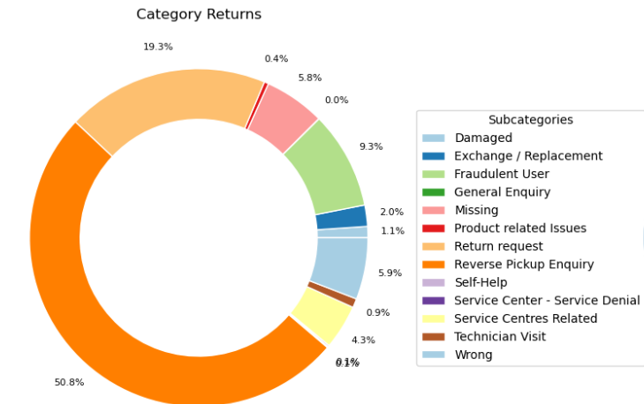
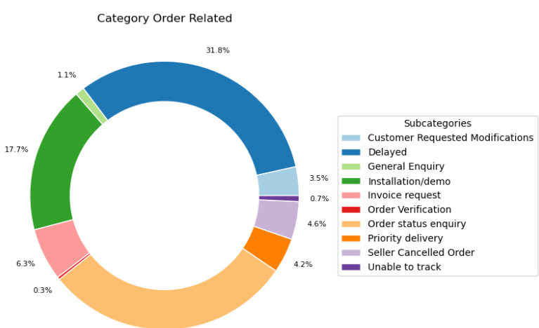
Part of sub-category pie chart

Slide 7
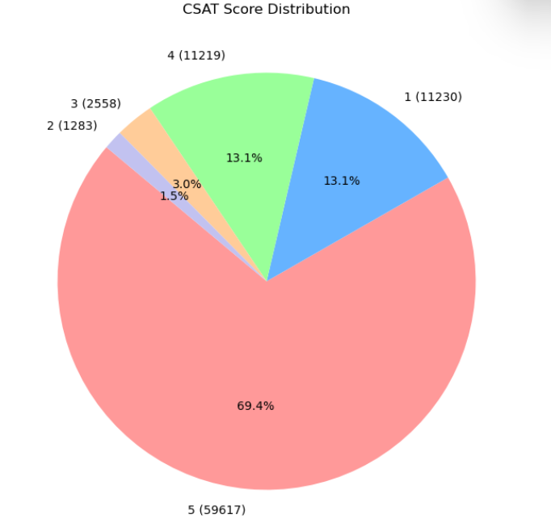
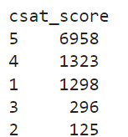
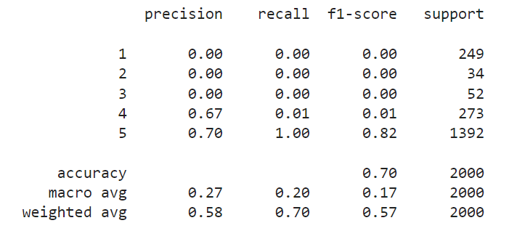
Modeling: with randomly sampled df

Slide 8
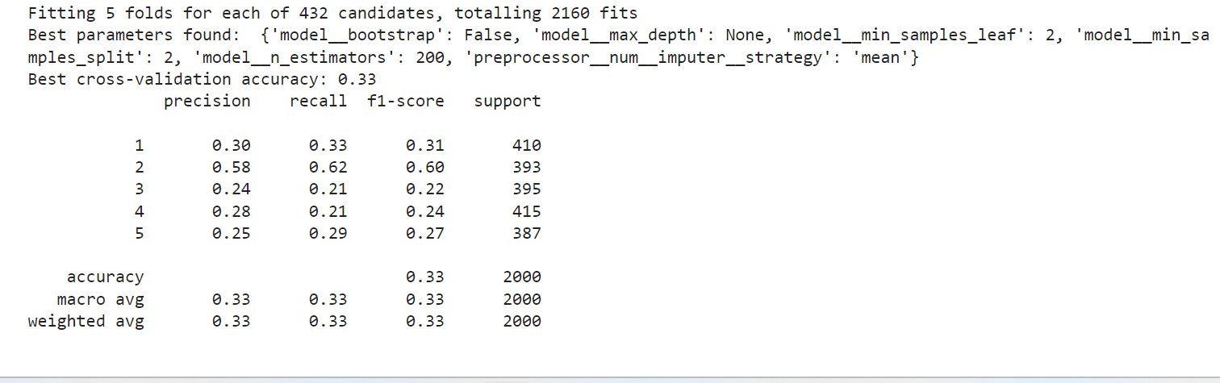
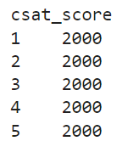
Modeling: even distribution after reducing columns + gridsearch

Slide 9
Limitations
Low correlation
Features with low correlation to the target variable contribute little information for predicting the target
Including low-correlation features can introduce noise, potentially confusing the model and degrading its performance
Low-correlation features often fail to capture relevant patterns, leading to lower model accuracy .
Computer
Gridsearch takes a very long time to give output

Slide 10
Thank you

Slide 11
Reference
eCommerce Customer Service Satisfaction, https://www.kaggle.com/datasets/ddosad/ecommerce-customer-service-satisfaction?resource=download
Fred Reichheld, Prescription for cutting costs, https://media.bain.com/Images/BB_Prescription_cutting_costs.pdf

